Slide 1
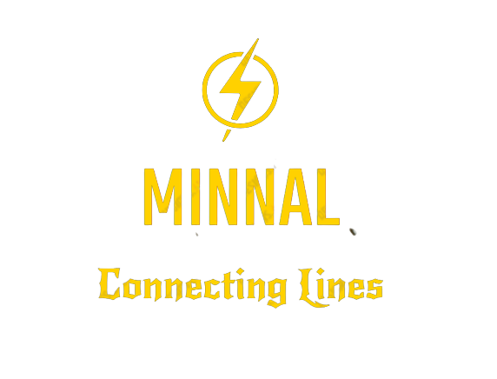

Slide 2
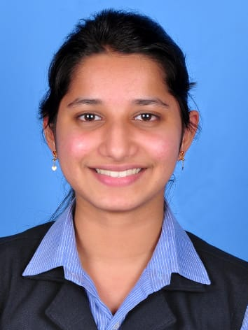
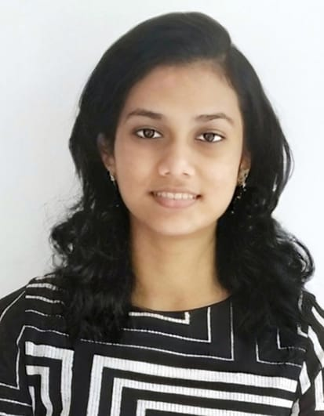
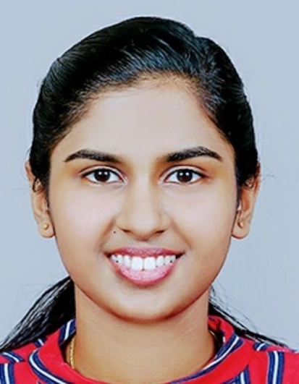
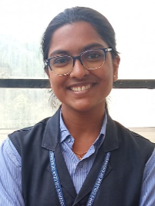
Team
Allwina Anna Soy Jose Alphy George Anita Augustine Anitta Siby
S6-CS-B-10 S6-CS-B-11 S6-CS-B-16 S6-CS-B-18
(Team Leader)

Slide 3
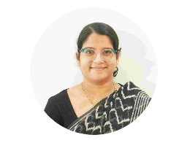
Project Guide
Prof. Maria Yesudas
Assistant Professor
Dept. Of Computer Science and Engineering
SJCET, Palai
mariayesudas@sjcetpalai.ac.in

Slide 4
Problem Statement
Inability to connect to the electricity board due to busy network lines and filling forms / telling details from scratch is time consuming. No proper response from board.

Slide 5
Project Scope
“Connecting Lines”
It is a platform through which consumers can easily connect with the authority in case of electricity complaints.
This project makes it easy to connect the board with just a click.
This project makes the consumer to fill in the consumer details only once and it will be saved and used for future reference.
There is no limit of adding consumers to this application. Hence, it is scalable. It will be a better way of organizing and connecting consumers to the board

Slide 6
Requirement Analysis
Data Collection
Functional Requirements
Non Functional Requirements

Slide 7
Data Collection
Data was collected from the consumers and the internet and the issues faced by consumers in the present scenario was identified.
We collected this data through :
Search through Website: Data from websites relating to complaint management system for the KSEB as well as papers published in international journals were referred.
Survey: Conducted a survey to analyze the issues faced by consumers when reporting a complaint.

Slide 8
Functional Requirements
Register and Login
Report Issues
Receive Notification about Consumer Issues
Send or receive Alert Messages
Check Whether the Issue is Resolved

Slide 9
Non-Functional Requirements
Performance Requirements
Safety Requirements
Security Requirements
Software Quality Attributes

Slide 10
Design
Use Case Diagram
Activity Diagram
Consumer
Board
ER Diagram

Slide 11
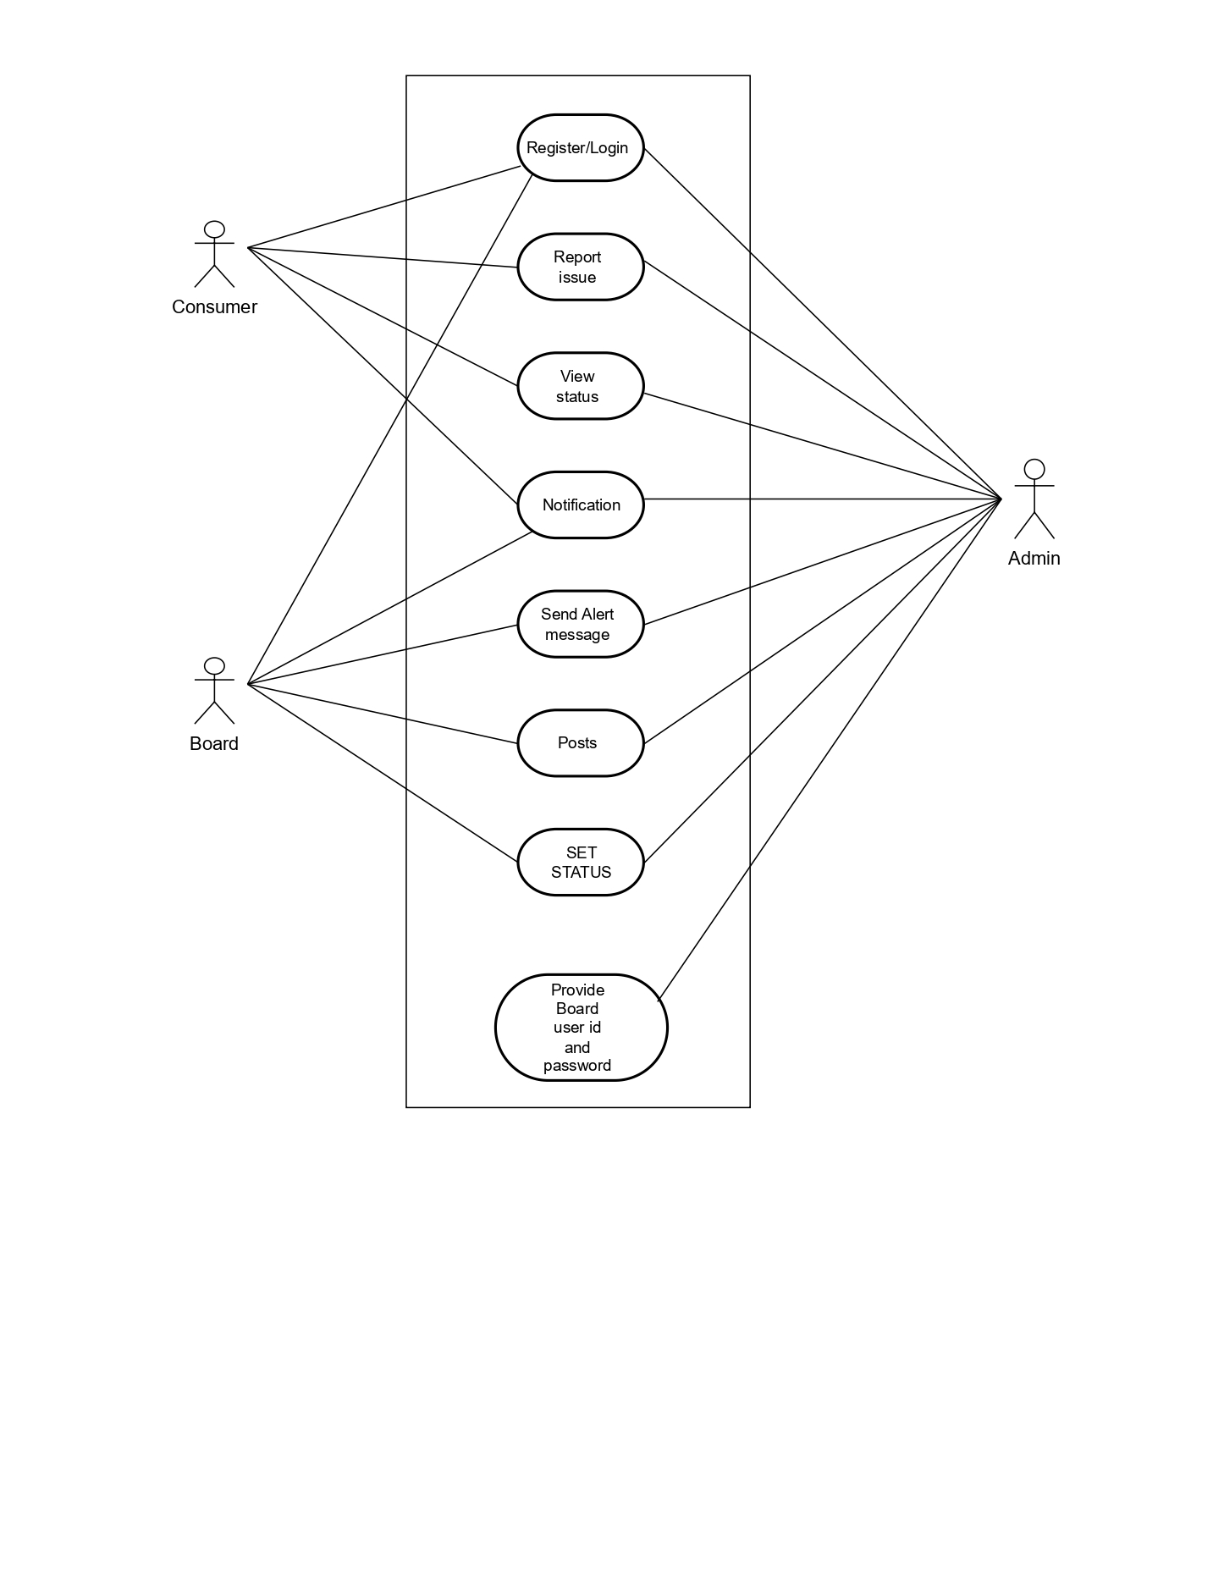
Use Case Diagram

Slide 12
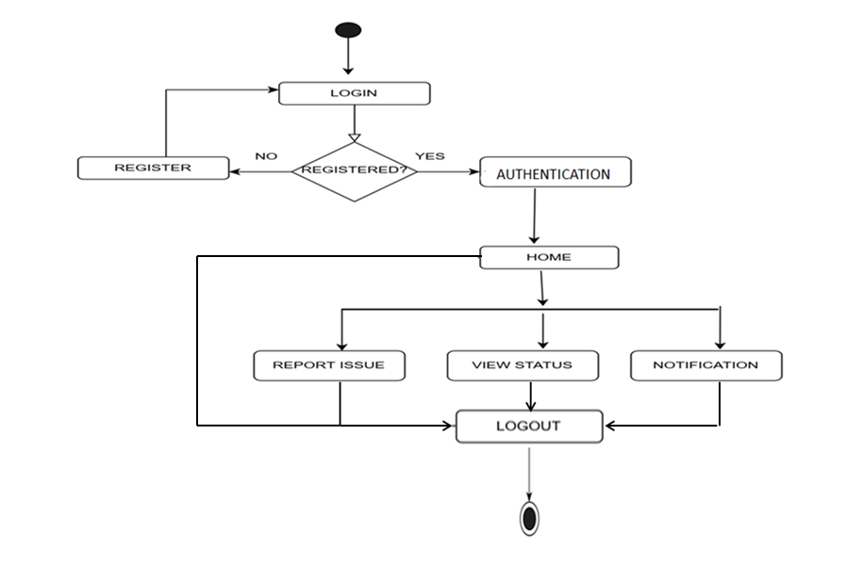
Activity Diagram: Consumer

Slide 13
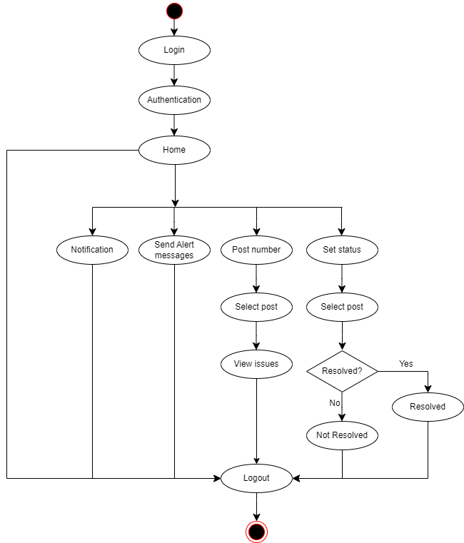
Activity Diagram: Board

Slide 14
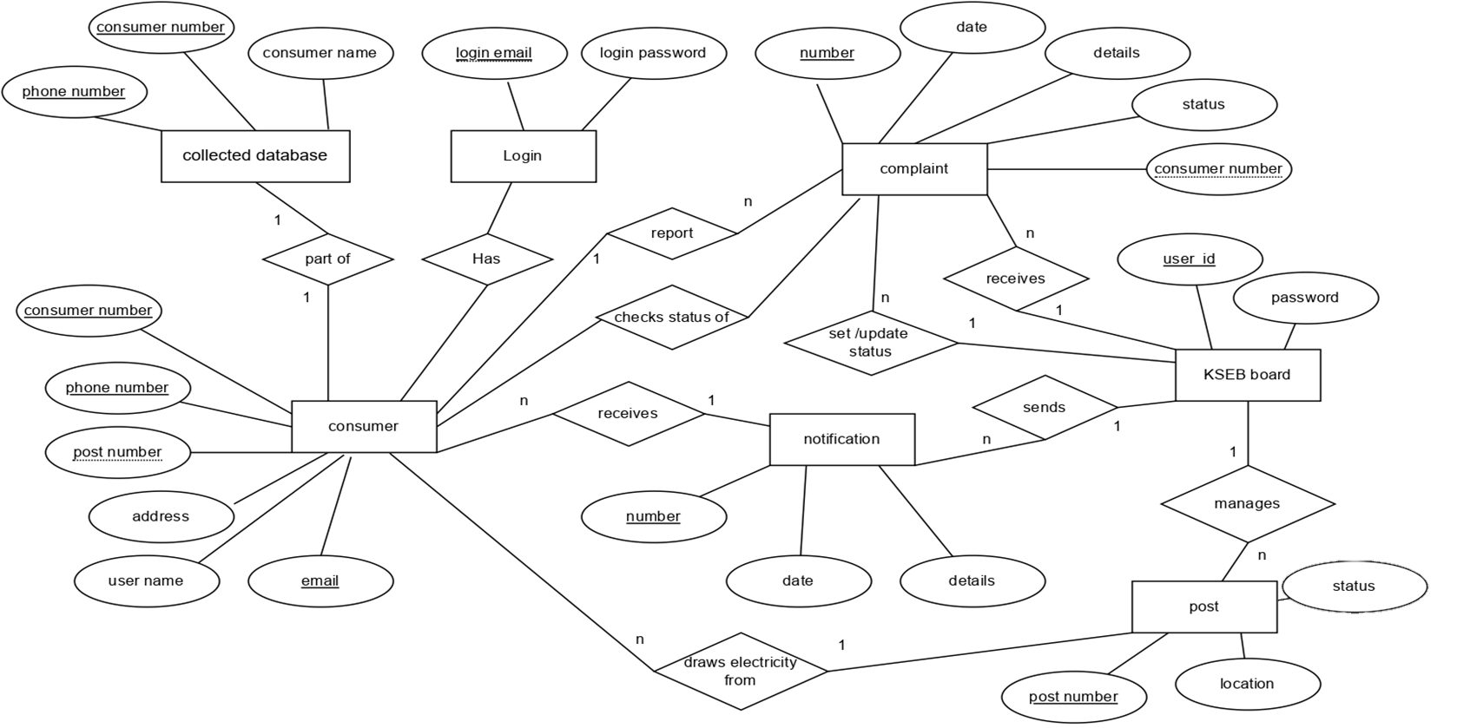
ER Diagram

Slide 15
Module Description
1. Administrator
provide username and password to electricity board.
2. Consumer:
Register and login
Report an issue
View status
Receive notification.
3. Board:
send alert messages and notification,
set status of issue.
View complaints under a post.

Slide 16
Technology Stack
Flutter
Flutter is an open-source UI software development kit (SDK) developed by Google .
Firebase
Firebase is a popular backend-as-a-service (BaaS) platform developed by Google.

Slide 17
Gantt Chart

Slide 18
THANK YOU

